Slide 1

Artificial Intelligence (AI101B) Even Semester Session 2024-25
Arun Kumar (202410116100040)
Ayushi Saran Singh (202410116100047)
Project Supervisor:
Mr. Apoorv Jain
Assistant Professor

Slide 2
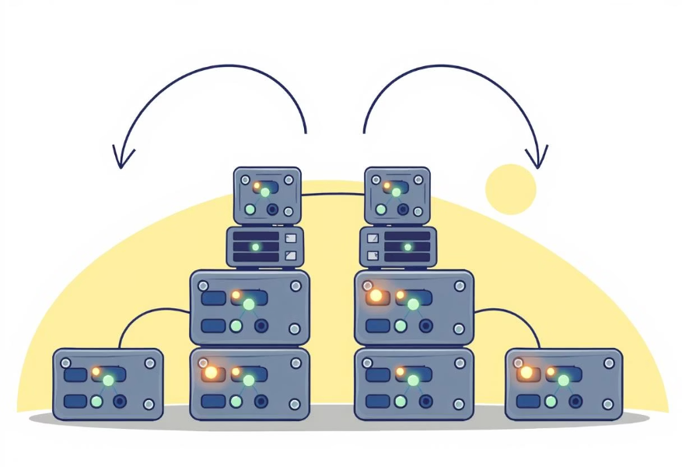
Introduction to Bidirectional Encoder Representations from Transformers (BERT)
It is based on the Transformer architecture, specifically the encoder part.
Bidirectional means it looks at both left and right context of a word simultaneously, unlike previous models that processed text in a single direction.
Pre-trained on massive text corpora (like English Wikipedia and BookCorpus), BERT already has deep knowledge of language before fine-tuning.
BERT is a foundation model, meaning it can be fine-tuned for various downstream NLP tasks with minimal task-specific architecture changes.
It revolutionized NLP by achieving state-of-the-art results in tasks like:Sentiment analysisQuestion answeringNamed entity recognitionText classification
BERT uses two pre-training objectives:
Masked Language Modeling (MLM): Predicting randomly masked words in a sentence.
Next Sentence Prediction (NSP): Predicting if two sentences logically follow each other.
BERT has several versions, such as:
bert-base-uncased (12 layers, 110M parameters)
bert-large-uncased (24 layers, 340M parameters)
DistilBERT (a smaller, faster version of BERT)

Slide 3

Project Objectives
Develop an AI-powered model using BERT and DistilBERT to accurately classify toxic comments across multiple categories.
Enhance real-time detection efficiency with a lightweight, fast, and scalable system suitable for deployment.
Promote safer online communities by helping platforms automatically detect and reduce harmful content.
Design a user-friendly interface that allows users to input comments and instantly receive toxicity predictions.
Support automated content moderation to assist organizations in enforcing community guidelines and reducing manual effort.

Slide 4
Timeline
Rise of Online Toxicity
The increase in online interactions has led to a surge in toxic comments.
Impact on Mental Health
Toxic comments can cause significant emotional distress and harm self-esteem.
Need for Classification Systems
Existing methods lack efficiency in identifying and filtering toxic content effectively.
Advances in AI Technology
Recent developments in AI have enabled improved classification of toxic comments.
Introduction of ToxiBERT
ToxiBERT aims to utilize BERT for enhanced toxic comment classification accuracy.

Slide 5



Introducing DistilBERT: A Smaller, Faster, Cheaper BERT
Knowledge Distillation
Efficiency Gains
Architectural Simplifications
DistilBERT is a distilled version of BERT, meaning it is trained to emulate the behavior of the larger BERT model (the "teacher") using a technique called knowledge distillation. The teacher model guides the student model's training by providing soft targets (probability distributions over classes), allowing the smaller model to learn complex patterns without the same number of parameters. This process significantly reduces the size of the model.
DistilBERT retains 97% of BERT's language understanding capabilities while being 40% smaller and 60% faster. This makes it ideal for deployment in resource-constrained environments or applications requiring low latency. The reduced computational footprint translates to lower inference costs and faster processing times, which is crucial for real-time applications.
To achieve its smaller size, DistilBERT removes the token-type embeddings, the pooler layer, and reduces the number of Transformer layers while keeping the dimension of the hidden states. These simplifications, combined with knowledge distillation, allow it to maintain high performance with fewer parameters, making it a highly efficient alternative to the full BERT model.
DistilBERT offers a compelling balance between performance and efficiency, addressing the practical challenges of deploying large language models.

Slide 6
Literature Review: The Evolution of Contextual Embeddings
Pre-Transformer Era (e.g., Word2Vec, GloVe)
Early contextual embedding models like Word2Vec and GloVe provided static word embeddings, where each word had a single, fixed vector representation regardless of its context. While groundbreaking for their time, they struggled with polysemy (words with multiple meanings) and lacked the ability to capture dynamic contextual nuances. These models primarily focused on learning word relationships from co-occurrence statistics in large corpora.
Early Contextual Models (e.g., ELMo)
ELMo (Embeddings from Language Models) introduced the concept of deep contextualized word representations, where a word's embedding was a function of the entire input sentence. It used a bidirectional LSTM network to generate context-dependent word vectors. This marked a significant step forward, allowing models to differentiate between different meanings of a word based on its usage in a sentence. However, ELMo's architecture was still sequential, limiting its parallelization capabilities.
The Rise of Transformers (e.g., GPT, BERT)
The Transformer architecture, with its self-attention mechanism, enabled highly parallelized training and the capture of long-range dependencies more effectively. GPT demonstrated the power of unidirectional Transformers for generative tasks, while BERT introduced bidirectional pre-training for powerful language understanding. These models significantly outperformed previous architectures across a wide range of NLP benchmarks, ushering in the modern era of large language models.
Model Compression and Efficiency (e.g., DistilBERT)
As Transformer models grew in size and computational demands, research shifted towards making them more efficient. Techniques like knowledge distillation emerged to create smaller, faster, and more deployable versions of these powerful models. DistilBERT is a prime example, showcasing how significant efficiency gains can be achieved with minimal loss in performance, making state-of-the-art NLP accessible for broader applications and real-world scenarios.

Slide 7
Workflow
Data Collection Process
Gathering data from various sources to ensure a robust dataset for training.
Data Cleaning Steps
Removing duplicates and irrelevant information to enhance the quality of the dataset.
Feature Extraction Method
Identifying key features to improve the classification accuracy of the model.
Model Training Phase
Training the model using BERT and DistilBERT to classify toxic comments effectively.
Evaluation and Testing
Assessing the model performance using evaluation metrics and validating results.

Slide 8
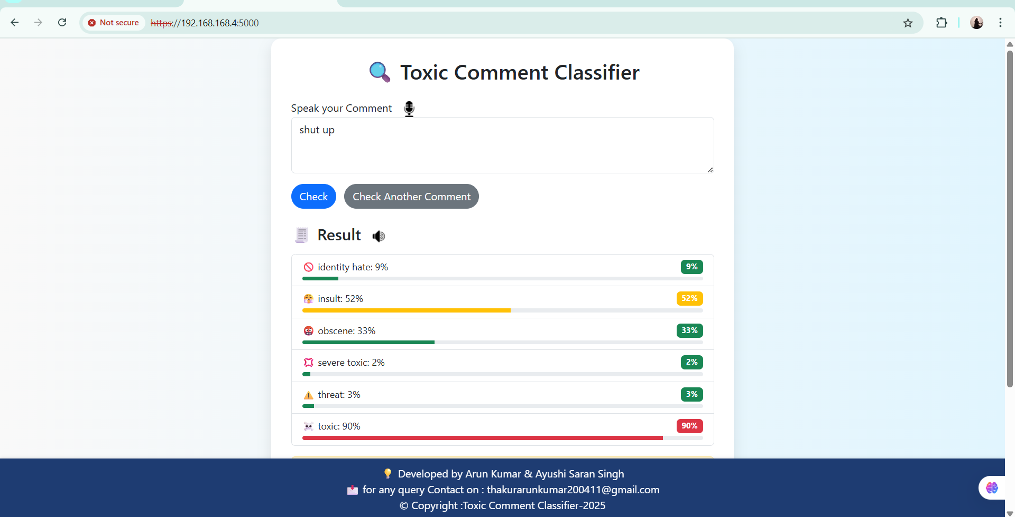
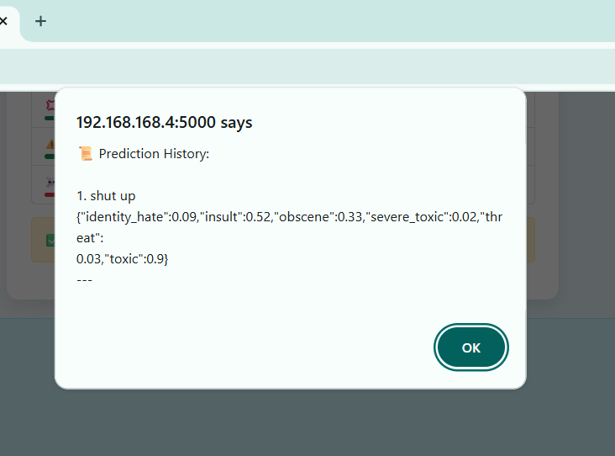
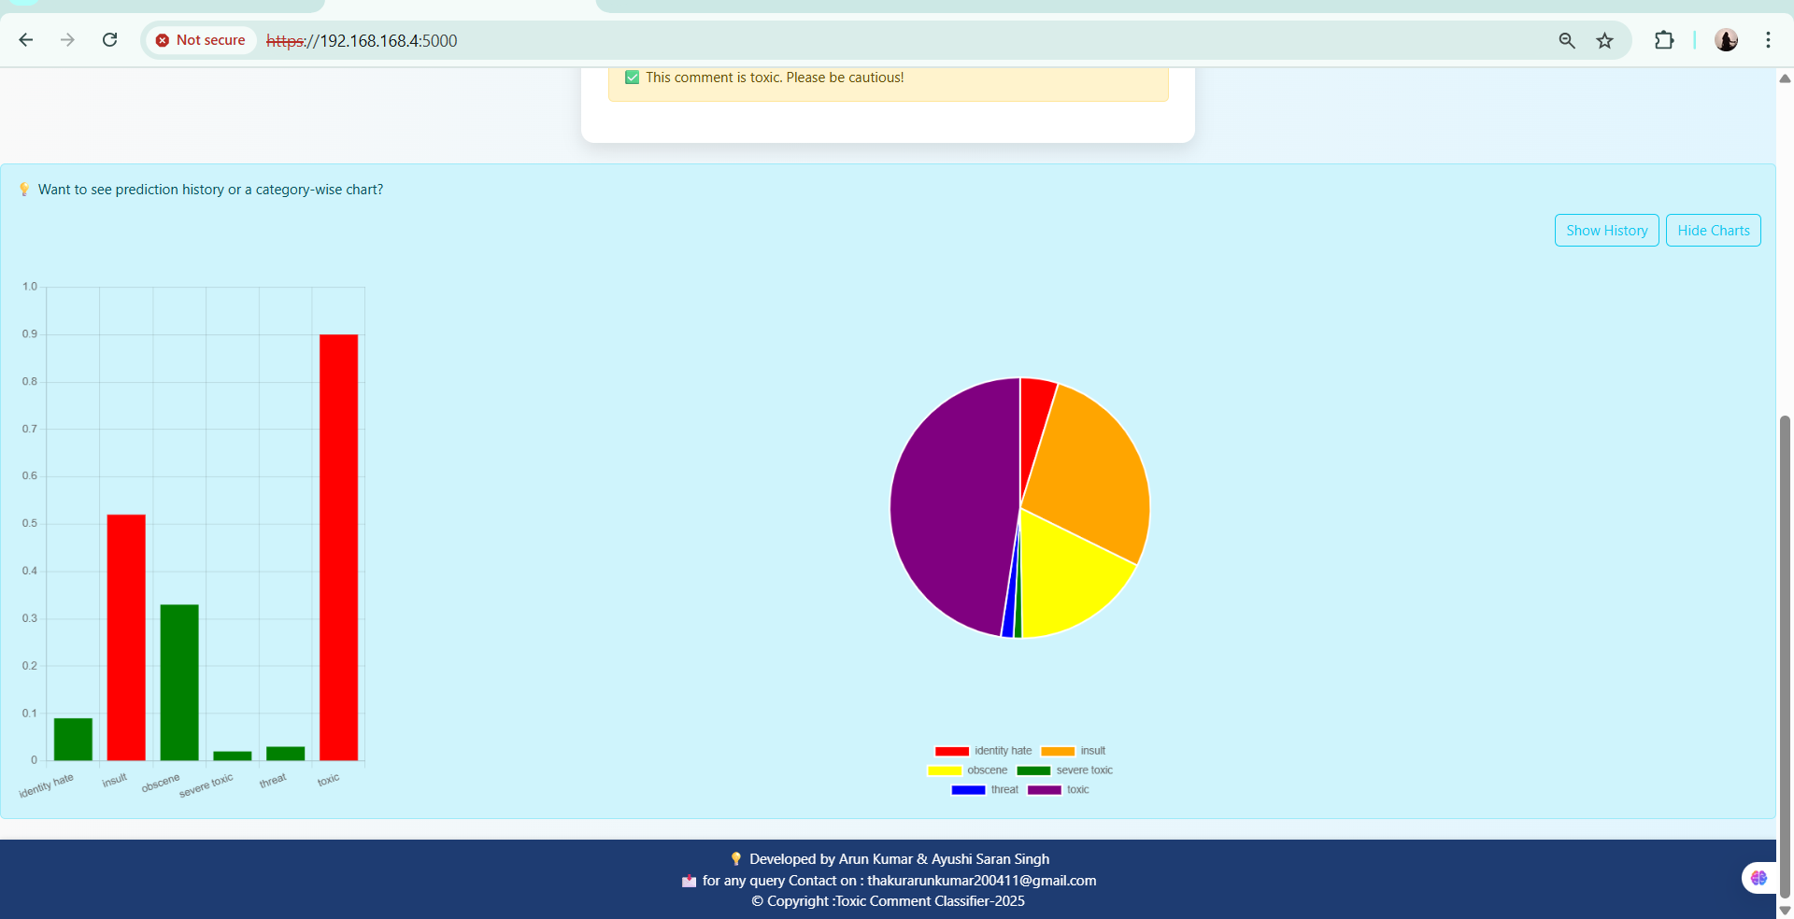
Experimental Results and Performance Analysis
Our experiments demonstrate the trade-offs between the full BERT model and its distilled counterpart, DistilBERT, on a sentiment analysis task. The results highlight that while BERT achieved slightly higher accuracy, DistilBERT provided significant improvements in inference speed, making it a more practical choice for real-time applications with limited computational resources.
BERT
DistilBERT
The performance metrics indicate that DistilBERT offers a compelling balance, sacrificing a minimal amount of accuracy for substantial gains in efficiency. The confusion matrices further revealed that both models performed similarly in identifying positive and negative sentiments, with minor differences in false positive and false negative rates, primarily in ambiguous cases.

Slide 9
Conclusion and Future Directions
In summary, BERT and DistilBERT represent significant breakthroughs in NLP, enabling advanced language understanding capabilities. BERT excels in scenarios where maximal accuracy is paramount and computational resources are abundant. DistilBERT, through knowledge distillation, provides a highly efficient alternative, making state-of-the-art NLP accessible for applications requiring faster inference and lower resource consumption.
Key Takeaways
Future Research
BERT's bidirectional training provides superior contextual understanding.
Explore further distillation techniques for even smaller models.
DistilBERT offers a compelling performance-to-efficiency trade-off.
Investigate the impact of quantization on model performance and efficiency.
Model selection depends on task requirements and resource constraints.
Apply these models to emerging NLP tasks like low-resource language understanding.
References
Devlin, J., Chang, M. W., Lee, K., & Toutanova, K. (2019). BERT: Pre-training of Deep Bidirectional Transformers for Language Understanding. Proceedings of NAACL-HLT 2019, 4171-4186.
Sanh, V., Debut, L., Chaumond, J., & Wolf, T. (2019). DistilBERT, a distilled version of BERT: smaller, faster, cheaper and lighter. arXiv preprint arXiv:1910.01108.
Vaswani, A., Shazeer, N., Parmar, N., Uszkoreit, J., Jones, L., Gomez, A. N., ... & Polosukhin, I. (2017). Attention Is All You Need. Advances in Neural Information Processing Systems, 30.

Slide 10
Thank You

